Slide 1

Hashing
COMP 272/400C:
Data Structures II
Prof. Silva
These slides were prepared by Prof. Silva adapting the slides from Data Structures & Algorithms in Java (Goodrich et al.) and Data Structures and Algorithm Analysis in Java (Weiss)
Notes:
Dictionaries

Slide 2
Map ADT
0
∅
1
025-612-0001
2
981-101-0002
3
∅
4
451-229-0004
Data
  a sequence of <key, value> pair where key is unique
Operations
  get(key)/lookup(key)
  put(key,value)/insert(key, value)
  remove(key)
Examples
  Student record, student id can be key
  People record, SSN can be the key
HashMaps and HashTables are good candidates to implement the map ADT and provide efficient lookup and update operations.
Hashing

Slide 3

Hash Functions and Hash Maps/Tables
A hash function h maps keys of a given type to integers in a fixed interval [0, N − 1]
Example:
h(x) = x mod N
is a hash function for integer keys
The integer h(x) is called the hash value of key x
A hash map/table for a given key type consists of
  Hash function h
  Array (called table) of size N
When implementing a map, the goal is to store item (k, o) at index i = h(k)
Hashing

Slide 4
Example
We design a hash map/table storing entries as (SSN, Name), where SSN (social security number) is a nine-digit positive integer
Our hash map/table uses an array of size N = 10,000 and the hash function
h(x) = last four digits of x
0
∅
1
025-612-0001
2
981-101-0002
3
∅
4
451-229-0004
…
9997
∅
9998
200-751-9998
9999
∅
Hashing

Slide 5

Hash Functions
A hash function is usually specified as the composition of two functions:
Hash code:
h₁: keys → integers
Compression function:
h₂: integers → [0, N − 1]
The hash code is applied first, and the compression function is applied next on the result, i.e.,
h(x) = h₂(h₁(x))
The goal of the hash function is to “disperse” the keys in an apparently random way
Hashing

Slide 6

Hash Codes
Memory address:
  We reinterpret the memory address of the key object as an integer (default hash code of all Java objects)
  Good in general, except for numeric and string keys
Integer cast:
  We reinterpret the bits of the key as an integer
  Suitable for keys of length less than or equal to the number of bits of the integer type (e.g., byte, short, int and float in Java)
Component sum:
  We partition the bits of the key into components of fixed length (e.g., 16 or 32 bits) and we sum the components (ignoring overflows)
  Suitable for numeric keys of fixed length greater than or equal to the number of bits of the integer type (e.g., long and double in Java)
Hashing

Slide 7
Hash Codes (cont.)
Polynomial accumulation:
  We partition the bits of the key into a sequence of components of fixed length (e.g., 8, 16 or 32 bits)
  a₀ a₁ … a_{n−1}
  We evaluate the polynomial
  p(z) = a₀ + a₁ z + a₂ z² + …
  … + a_{n−1}z^{n−1}
  at a fixed value z, ignoring overflows
  Especially suitable for strings (e.g., the choice z = 33 gives at most 6 collisions on a set of 50,000 English words)
Polynomial p(z) can be evaluated in O(n) time using Horner’s rule:
  The following polynomials are successively computed, each from the previous one in O(1) time
  p₀(z) = a_{n−1}
  p_{i} (z) = a_{n−i−1} + zp_{i−1}(z)
  (i = 1, 2, …, n −1)
We have p(z) = p_{n−1}(z)
Hashing

Slide 8

Compression Functions
Division:
  h₂ (y) = y mod N
  The size N of the array is usually chosen to be a prime
  The reason has to do with number theory and is beyond the scope of this course
Multiply, Add and Divide (MAD):
  h₂ (y) = (ay + b) mod N
  a and b are nonnegative integers such that
  a mod N ≠ 0
  Otherwise, every integer would map to the same value b
Hashing

Slide 9

Collision Handling
Collisions occur when different elements are mapped to the same cell
Separate Chaining: let each cell in the array point to a linked list of entries that map there
0
∅
1
025-612-0001
2
∅
3
∅
4
451-229-0004
981-101-0004
Separate chaining is simple, but requires additional memory outside the array
Hashing

Slide 10
Map with Separate Chaining
Delegate operations to a list-based map at each cell:
Algorithm get(k):
return A[h(k)].get(k)
Algorithm put(k,v):
t = A[h(k)].put(k,v)
if t = null then {k is a new key}
n = n + 1
return t
Algorithm remove(k):
t = A[h(k)].remove(k)
if t ≠ null then {k was found}
n = n - 1
return t
Hashing

Slide 11
Linear Probing
Open addressing: the colliding item is placed in a different cell of the array
Linear probing: handles collisions by placing the colliding item in the next (circularly) available array cell
Each array cell inspected is referred to as a “probe”
Colliding items lump together, causing future collisions to cause a longer sequence of probes
Example:
  h(x) = x mod 13
  Insert keys 18, 41, 22, 44, 59, 32, 31, 73, in this order
0
1
2
3
4
5
6
7
8
9
10
11
12
41
18
44
59
32
22
31
73
0
1
2
3
4
5
6
7
8
9
10
11
12
Hashing

Slide 12

Search with Linear Probing
Consider a hash map/table A that uses linear probing
get(k)
  We start at cell h(k)
  We probe consecutive locations until one of the following occurs
    An item with key k is found, or
    An empty cell is found, or
    N cells have been unsuccessfully probed
Algorithm get(k)
i ← h(k)
p ← 0
repeat
c ← A[i]
if c = ∅
return null
else if c.getKey () = k
return c.getValue()
else
i ← (i + 1) mod N
  p ← p + 1
  until p = N
return null
Hashing

Slide 13
Updates with Linear Probing
To handle insertions and deletions, we introduce a special object, called AVAILABLE, which replaces deleted elements
remove(k)
  We search for an entry with key k
  If such an entry (k, o) is found, we replace it with the special item AVAILABLE and we return element o
  Else, we return null
put(k, o)
  We throw an exception if the array is full
  We start at cell h(k)
  We probe consecutive cells until one of the following occurs
    A cell i is found that is either empty or stores AVAILABLE, or
    N cells have been unsuccessfully probed
  We store (k, o) in cell i
Hashing

Slide 14

Double Hashing
Double hashing uses a secondary hash function d(k) and handles collisions by placing an item in the first available cell of the series
(h(k) + jd(k)) mod N
for j = 0, 1, … , N −1.
The secondary hash function d(k) cannot have zero values
The array size N must be a prime to allow probing of all the cells
Common choice of compression function for the secondary hash function:
  d(k) = q − (k mod q)
where
  q < N
  q is a prime
The possible values for d(k) are
1, 2, … , q
Hashing

Slide 15
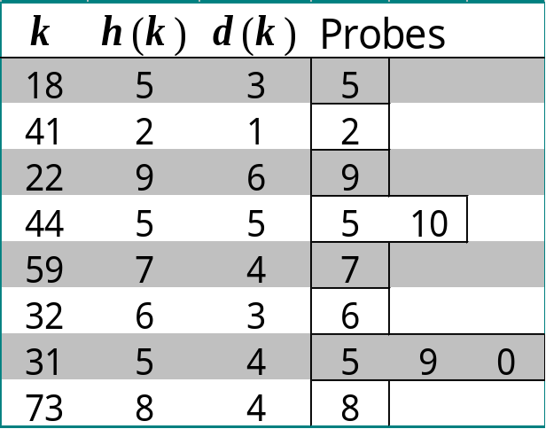
Example of Double Hashing
Consider a hash map/table storing integer keys that handles collision with double hashing
  N = 13
  h(k) = k mod 13
  d(k) = 7 − k mod 7
Insert keys 18, 41, 22, 44, 59, 32, 31, 73, in this order
0
1
2
3
4
5
6
7
8
9
10
11
12
31
41
18
32
59
73
22
44
0
1
2
3
4
5
6
7
8
9
10
11
12
Hashing

Slide 16

Performance of Hashing
In the worst case, searches, insertions and removals on a hash map/table take O(n) time
The worst case occurs when all the keys inserted into the map collide
The load factor α = n/N affects the performance of a hash map/table
Assuming that the hash values are like random numbers, it can be shown that the expected number of probes for an insertion with open addressing is
1 / (1 − α)
The expected running time of all the dictionary ADT operations in a hash map/table is O(1)
In practice, hashing is very fast provided the load factor is not close to 100%
Applications of hash maps/tables:
  small databases
  compilers
  browser caches
Hashing

Slide 17
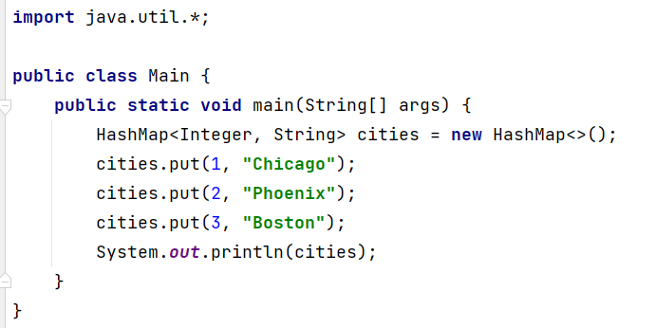
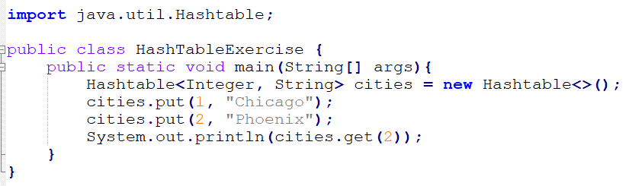
Java HashMap and HashTable
HashTable is considered a legacy class
Hashing

